Slide 1



Course: Image Processing 31651 Assignment #22 Pixel to Pixel Operations (Part 2)
Photo of the student | Shorten Name | ID (4 last digits)
 | shienfeld | 1950 | Student #1
 | pony | 2210 | Student #2
 | akimov | 7939 | Student #3
Photo of the student | Shorten Name | ID (4 last digits)
 | shienfeld | 1950 | Student #1
 | pony | 2210 | Student #2
 | akimov | 7939 | Student #3

Slide 2
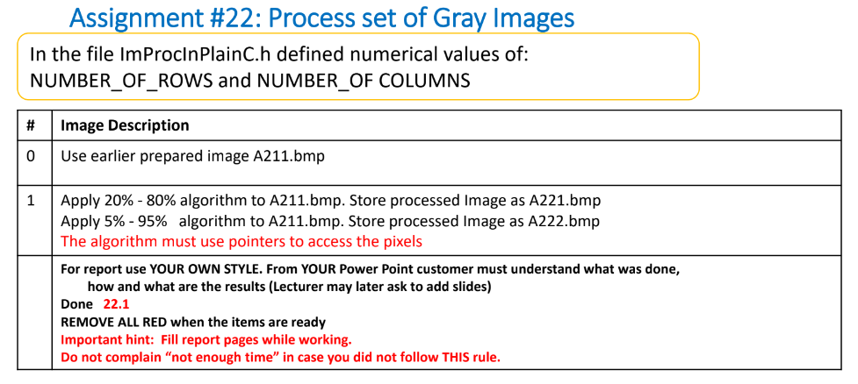
Pay attention:
The main difference between that assignment (22) and the previews one (21) is the selection of the ‘b’ and ‘c’ constants. Now we need to create a histogram and to integrate it for calculating the ‘b’ and ‘c’ constants for the LUT. (In assignment 21 constants were selected using a simple formula given in the assignment)

Slide 3

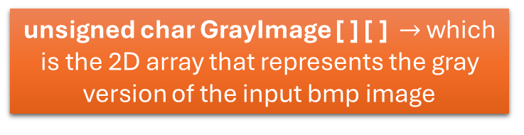
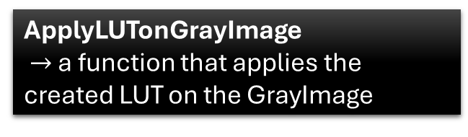
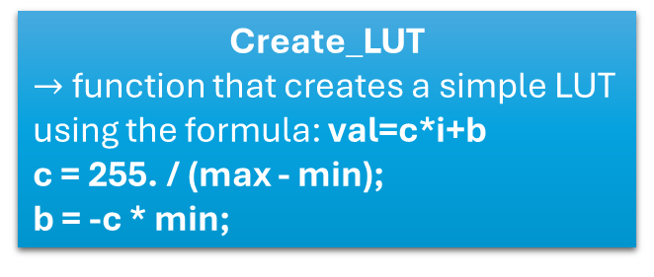
22.0 - flow chart of the code
A211.bmp a corrupted gray image (spoiled) created in Assignment #21 – saved in bmp format
LoadGrayImageFromGrayBmpFile
Create a histogram and calculate the Cumulative Histogram (Integral Histogram) of the GrayImage [ ] [ ]
unsigned char GrayImage [ ] [ ] $→$ which is the 2D array that represents the gray version of the input bmp image
Create_LUT
$→$ function that creates a simple LUT using the formula: val=c*i+b
c = 255. / (max - min);
b = -c * min;
Calculate the max and the min of the Cumulative Histogram. The max and the min will be the main factors for the ‘b’ and ‘c’ constants for creating a LUT
StoreGrayImageAsGrayBmpFile $→$Store the new GrayImage as a bmp file (after transformation using LUT)
ApplyLUTonGrayImage
$→$ a function that applies the created LUT on the GrayImage

Slide 4
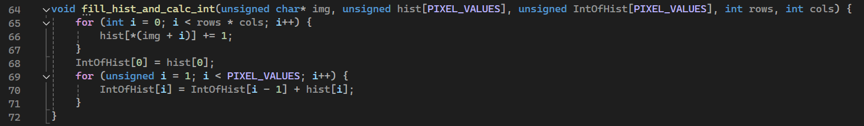
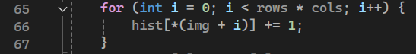
22.1 – first important function – create a histogram and its integral – part 1/2
The fill_hist_and_calc_int function is responsible for:
Calculating the Histogram: Counting the number of occurrences of each pixel value in the image.
Calculating the Cumulative Histogram (Integral Histogram): Computing the cumulative sum of the histogram values.
hist is an array of size 256 (PIXEL_VALUES), where each index corresponds to a pixel value (0-255).
hist[i] represents the count of pixels in the image that have the value i
After the histogram calculation, hist contains the frequency distribution of pixel values in the image.
*(img + i) accesses the pixel value at the i-th position using pointer arithmetic.
This loop iterates over all the pixels in the image (total rows * cols pixels).
hist[*(img + i)] += 1 increments the count for the pixel value in the histogram array. It counts how many times each pixel value (0-255) appears in the image.

Slide 5
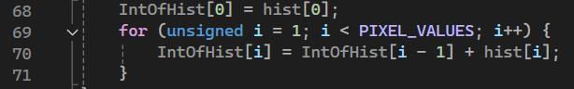
22.1 – first important function – create a histogram and its integral – part 2/2
IntOfHist[0] = hist[0]: Initializes the first value of the cumulative histogram with the first value of the histogram.
The loop iterates over all possible pixel values (0-255).
IntOfHist[i] = IntOfHist[i - 1] + hist[i] computes the cumulative sum for each pixel value, effectively creating the cumulative histogram.
IntOfHist is also an array of size 256.
IntOfHist[i] represents the cumulative count of pixels with values from 0 to i.
After the cumulative histogram calculation, IntOfHist contains the cumulative distribution of pixel values, which is useful for certain image processing techniques, such as histogram equalization.

Slide 6
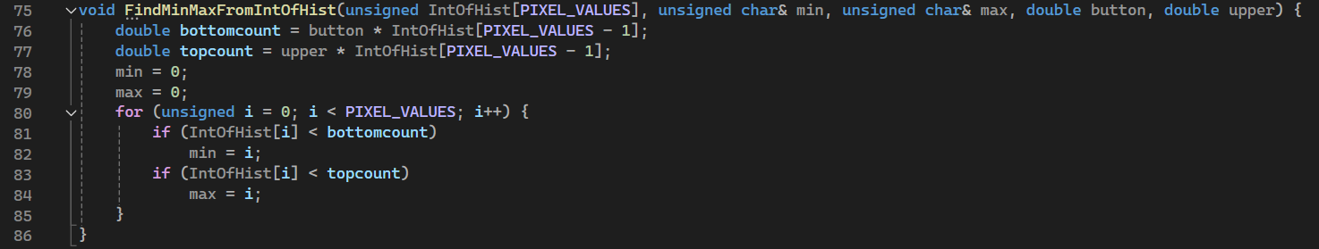
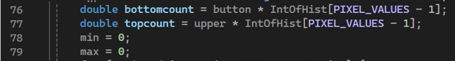
22.2 – second important function – find max and min from histogram– part 1/2
The FindMinMaxFromIntOfHist function is designed to determine the minimum and maximum pixel values in an image based on specified percentage limits (button and upper). This is done using the cumulative histogram (IntOfHist).
bottomcount is calculated by multiplying the lower percentage limit (button) by the total number of pixels (IntOfHist[PIXEL_VALUES - 1]), which is the last value in the cumulative histogram.
topcount is calculated similarly using the upper percentage limit (upper).
min and max are initialized to 0. These will store the minimum and maximum pixel values found within the specified limits.

Slide 7
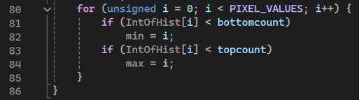
22.2 – second important function – find max and min from histogram– part 2/2
This loop iterates through all possible pixel values (0 to 255):
if (IntOfHist[i] < bottomcount) $→$ If the cumulative histogram value at i is less than bottomcount, update min to i. This finds the pixel value corresponding to the lower percentage limit
if (IntOfHist[i] < topcount) $→$ If the cumulative histogram value at i is less than topcount, update max to i. This finds the pixel value corresponding to the upper percentage limit.

Slide 8
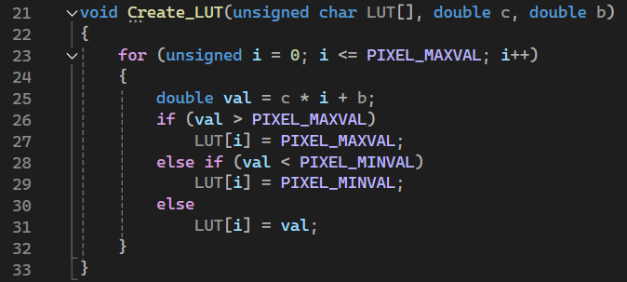
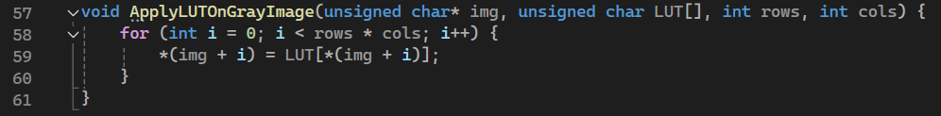
22.3 – third important function – create a LUT and apply it on the image
Create_LUT is a very simple function for creating a LUT using the contrast (c) and brightness (b) constants.
After defining the LUT – we need to apply the LUT of the original gray image (img [ ] [ ] )

Slide 9
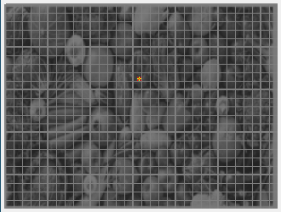
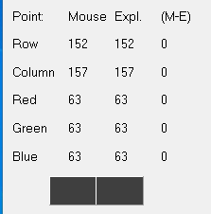
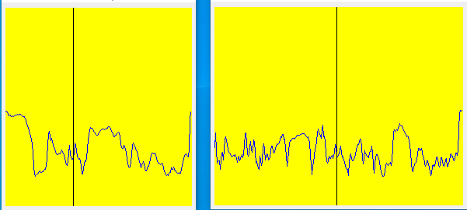
Original photo (spoiled): A211.bmp
Both for the point (152,157)

Slide 10
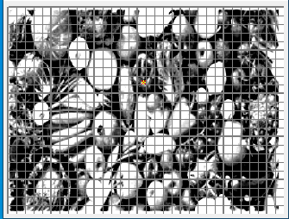
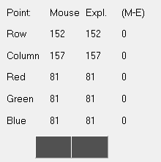
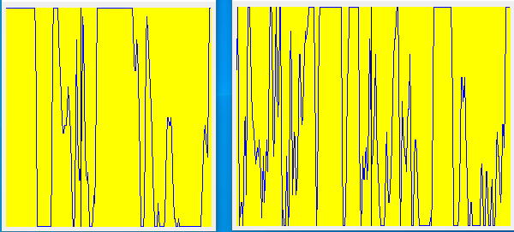
25%-75% Algorithm applied on A211.bmp image
Both for the point (152,157)

Slide 11
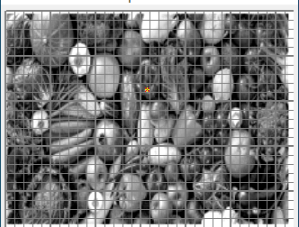
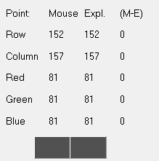
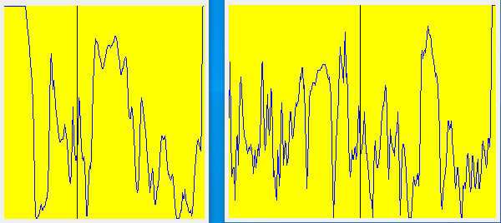
5%-95% Algorithm applied on A211.bmp image
Both for the point (152,157)

Slide 12
63
81
81

Slide 13
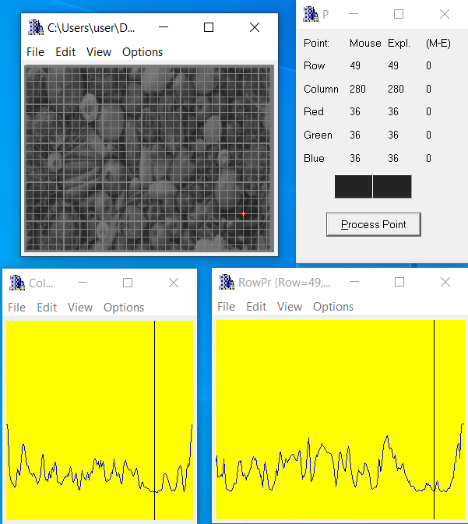
Original photo (spoiled): A211.bmp
Both for the point (49,279)

Slide 14
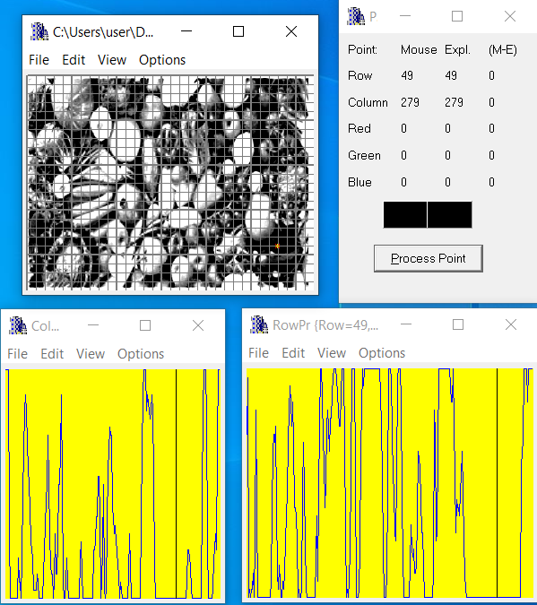
25%-75% Algorithm applied on A211.bmp image

Slide 15
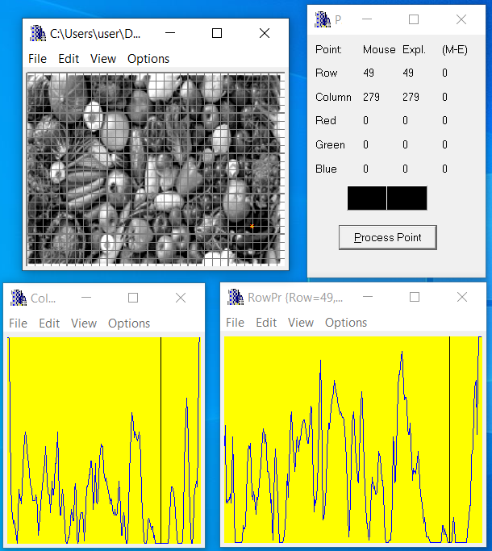
5%-95% Algorithm applied on A211.bmp image
Both for the point (49,279)

Slide 16
36
Here we can see that unlike the Original spoiled photo values are more “balanced” and in our 5%-95% photo they vary from the bottom to the top as shown using BMPViewer profilers below:
0
0

Slide 17
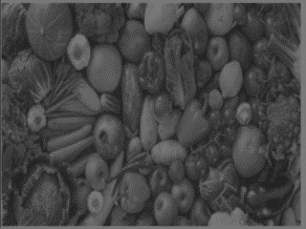
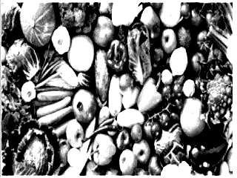
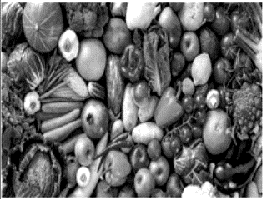
On 25%-75% image (A2211.Bmp) we can see that the contrast is very high and it is quite easy to distinguish between objects and on the 5%-95% image (A2221.Bmp) we can as well distinguish easily between objects.
The difference between the two is that 5%-95% image looks way more realistic than 25%-75% and less distorted.
We can say that the original spoiled image might be brighter (hard to see that..) but the fruits and vegetables in our fixed image are way more clear and convenient to watch (better contrast).

Slide 18
22.15 What did we learned
We learned to improve an image using the principle of accumulative histograma.
2) We learned that it is better to take small portion (5% instead of 25% for example) in order to improve the image and it’s objects visibility.

